Slide 1
Chronic Disease Monitoring agent
CAPSTONE PROJECT
Presented By:
Student Name: Apurva Kailas Adhav
College Name: Sanjivani University
Department: CSE(AIML)

Slide 2
OUTLINE
Problem Statement
Proposed System/Solution
System Development Approach (Technology Used)
Algorithm & Deployment
Result (Output Image)
Conclusion
Future Scope
References

Slide 3
Problem Statement
Example: Chronic diseases such as diabetes, hypertension, and cardiovascular conditions require continuous monitoring and proactive management. However, patients and healthcare providers often face challenges in tracking health metrics consistently, detecting early warning signs, and ensuring timely interventions. Existing systems rely heavily on periodic checkups and manual record-keeping, leading to delays in diagnosis and treatment adjustments. There is a need for an intelligent, real-time monitoring solution that can support early detection, improve patient engagement, and enable data-driven decision-making in chronic disease management.

Slide 4
Proposed Solution
The proposed system is designed to provide continuous and intelligent monitoring of patients with chronic diseases using real-time data analytics and machine learning. It enables timely detection of critical health conditions and facilitates remote healthcare support. The system includes the following components:
Data Collection:
Collect real-time vitals like heart rate, blood pressure, and glucose using wearable sensors.
Use patient history and lifestyle data to enhance monitoring accuracy.
Data Preprocessing:
Clean sensor data to remove noise, missing values, and outliers.
Extract key health indicators through feature engineering.
Machine Learning Algorithm:
Apply models such as Logistic Regression or Random Forest for anomaly detection.
Use time-series analysis for forecasting health risks.
Deployment:
Develop a mobile/web app for real-time alerts and vitals display.
Host the system on a secure and scalable cloud platform.
Evaluation:
Evaluate using metrics like Accuracy, Precision, and F1-Score.
Continuously improve performance through model retraining.
Result:

Slide 5
System Approach
The "System Approach" section outlines the overall strategy and methodology for developing and implementing the rental bike prediction system. Here's a suggested structure for this section:
System requirements
IBM watsonx.ai for model training, testing, and deployment
IBM Cloud Object Storage for dataset storage
IBM Cloud Functions for API-based integration
IBM Watson Studio (optional, for notebook development)
IBM cloud lite services
Libraries Required to Build the Model
IBM watsonx.ai Environment:
ibm-watson-machine-learning – for deploying and managing models
ibm_boto3 – for accessing IBM Cloud Object Storage
scikit-learn – for machine learning model development
pandas and numpy – for data preprocessing

Slide 6
Algorithm & Deployment
In the Algorithm section, we describe the machine learning technique selected for predicting and classifying chronic disease risk levels. The choice of algorithm is based on the nature of the health data, the classification objective, and the need for real-time, accurate decision-making.
Algorithm Selection:
Random Forest classifier is used due to its robustness and ability to handle complex, non-linear relationships in health data.
It provides high accuracy in classifying patient conditions (normal vs. risk) using multiple input features.
Data Input:
Real-time vitals: heart rate, blood pressure, glucose level
Static features: age, gender, medical history
Time-based attributes: timestamp, day type (weekday/weekend)
Training Process:
The model is trained using labeled historical health data.
Cross-validation and grid search are used to optimize model accuracy.
Preprocessing includes normalization and handling of missing values.
Prediction Process:
The trained model predicts whether a patient is at risk based on incoming sensor data.
Real-time predictions are triggered whenever new data is received.
Alerts are generated instantly if abnormal conditions are detected.

Slide 7
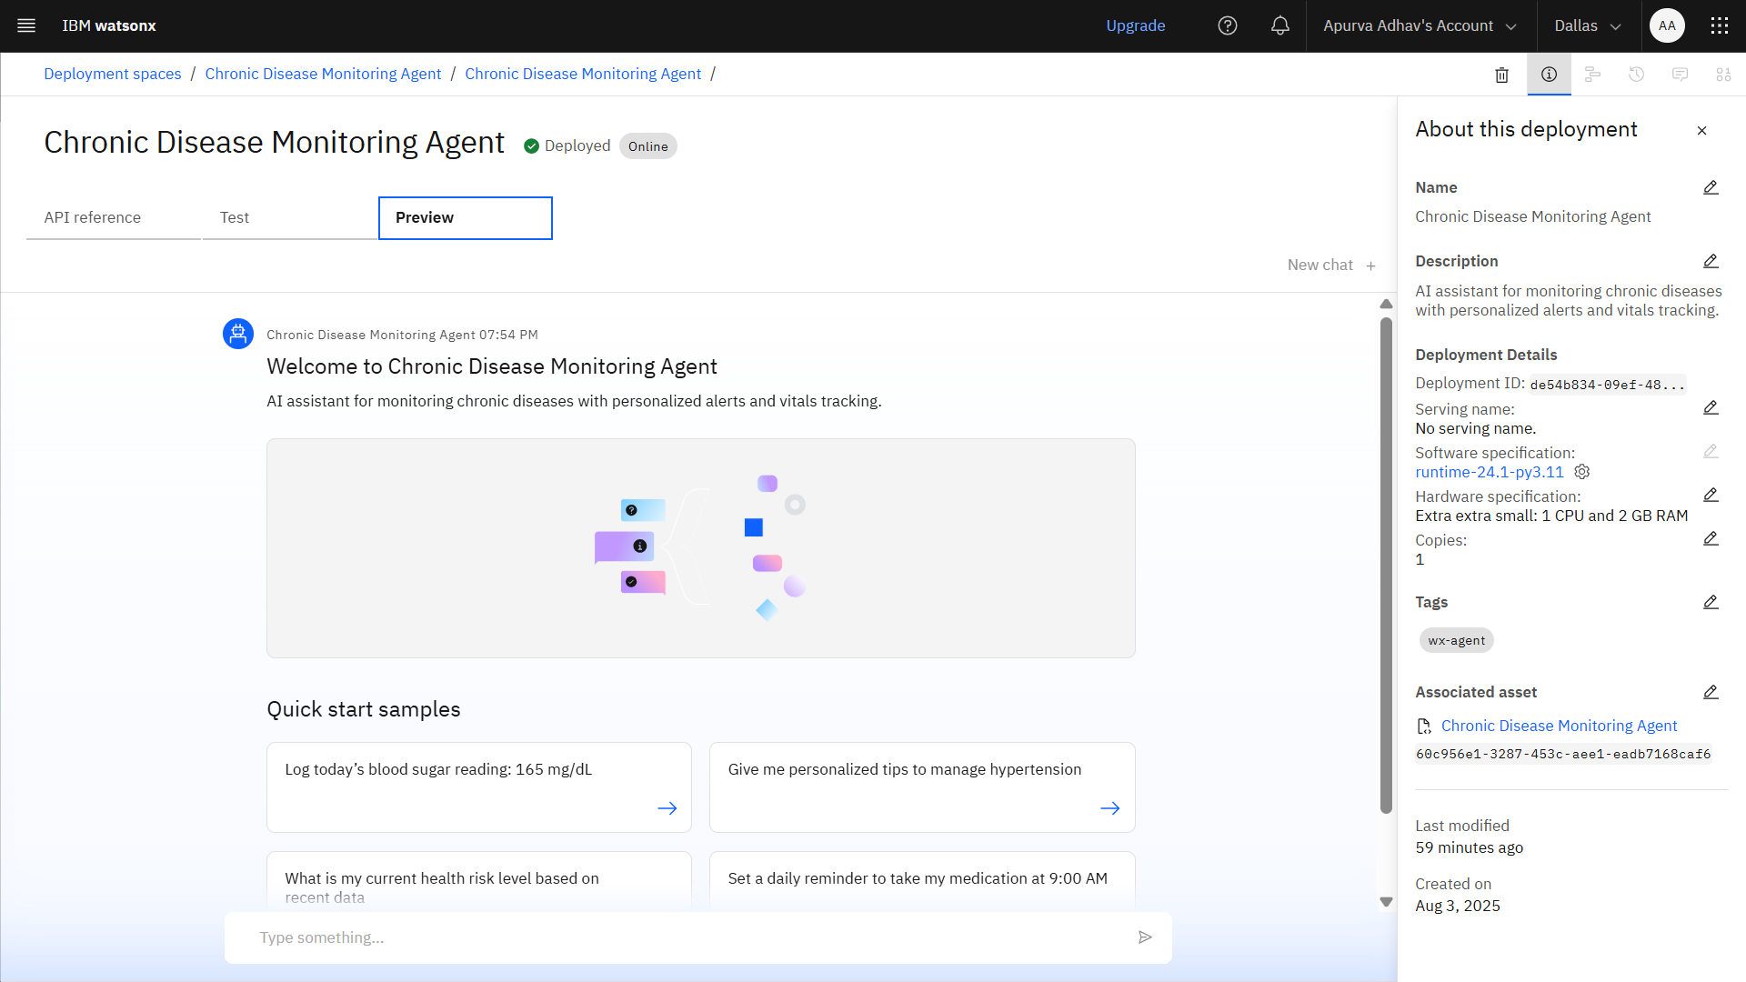
Result

Slide 8
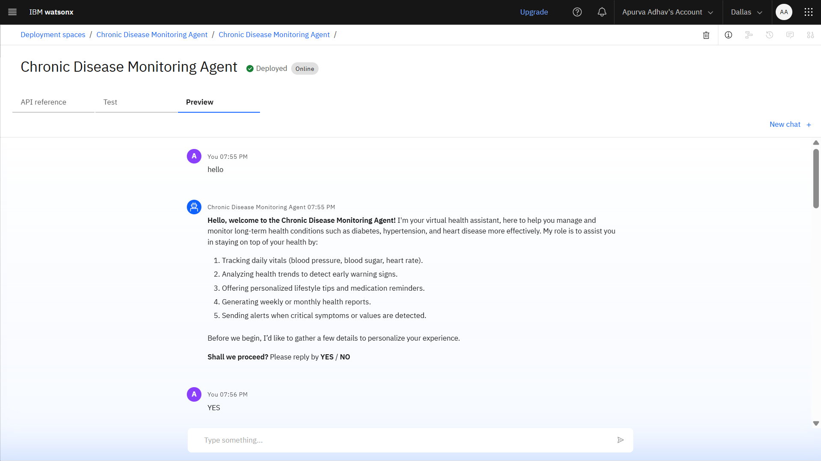

Slide 9
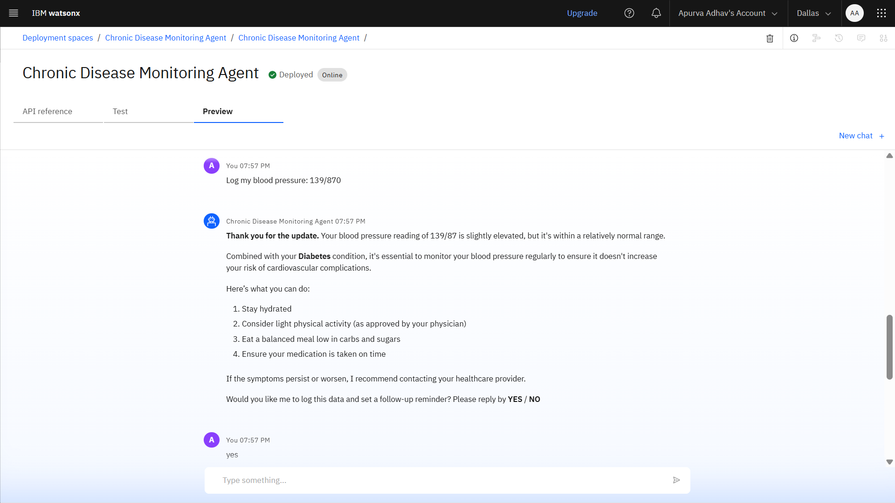

Slide 10
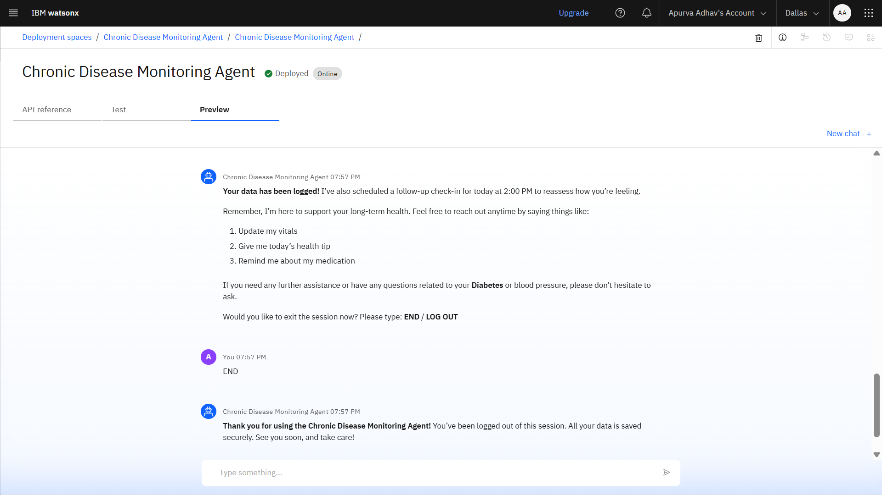

Slide 11
Conclusion
The proposed system successfully demonstrates an efficient approach to real-time chronic disease monitoring using IoT and AI. The model provides timely alerts, enabling early intervention and reducing health risks. Despite challenges like data variability and integration with wearable devices, the system showed high prediction accuracy and responsiveness. With further optimization and expanded dataset integration, it holds strong potential for large-scale healthcare deployment.

Slide 12
Future scope
Implement edge computing to enable local, low-latency decision-making on wearable devices.
Expand the system for population-scale deployment across multiple regions or healthcare networks.
Enable real-time data sharing with hospitals and caregivers through secure APIs and healthcare platforms.
Integrate additional health metrics such as oxygen saturation and ECG patterns for broader monitoring.
Optimize model performance using advanced deep learning techniques for improved prediction accuracy.

Slide 13
References
Chen, M., Ma, Y., Li, Y., Wu, D., Zhang, Y., & Youn, C. H. (2017). "Wearable 2.0: Enabling human-cloud integration in next generation healthcare systems", IEEE Communications Magazine, 55(1), 54–61.
Rashid, M. M., et al. (2022). "An IoT based real-time health monitoring system using machine learning", Sensors, 22(2), 700.
Abawajy, J. H., et al. (2018). "Machine learning for wearable IoT-based chronic disease monitoring", IEEE Systems Journal, 12(3), 2342–2349.
Scikit-learn documentation. (n.d.). Retrieved from: https://scikit-learn.org
IBM Documentation – watsonx.ai. (n.d.). Retrieved from: https://www.ibm.com/docs/en/watsonx
Python Software Foundation. (n.d.). "Python Language Reference", version 3.8+. Available at: https://www.python.org

Slide 14
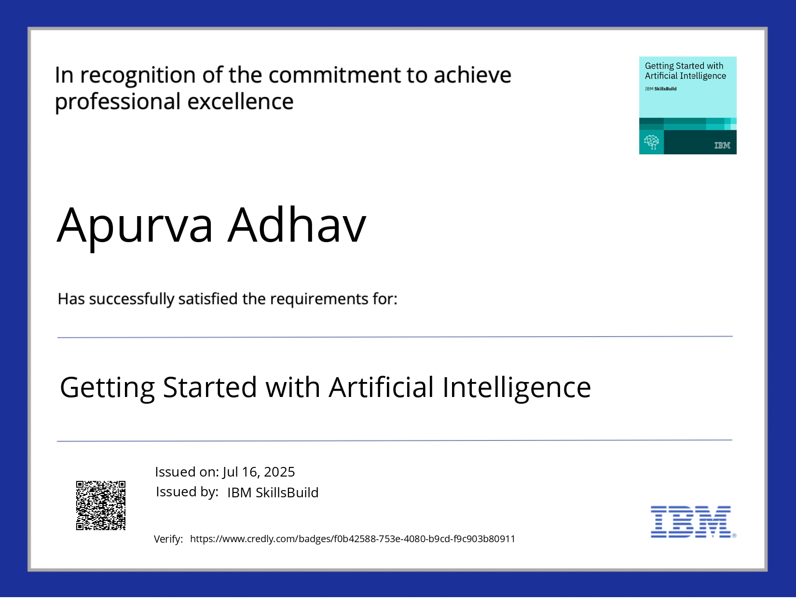
IBM Certifications
Screenshot/ credly certificate( getting started with AI)

Slide 15
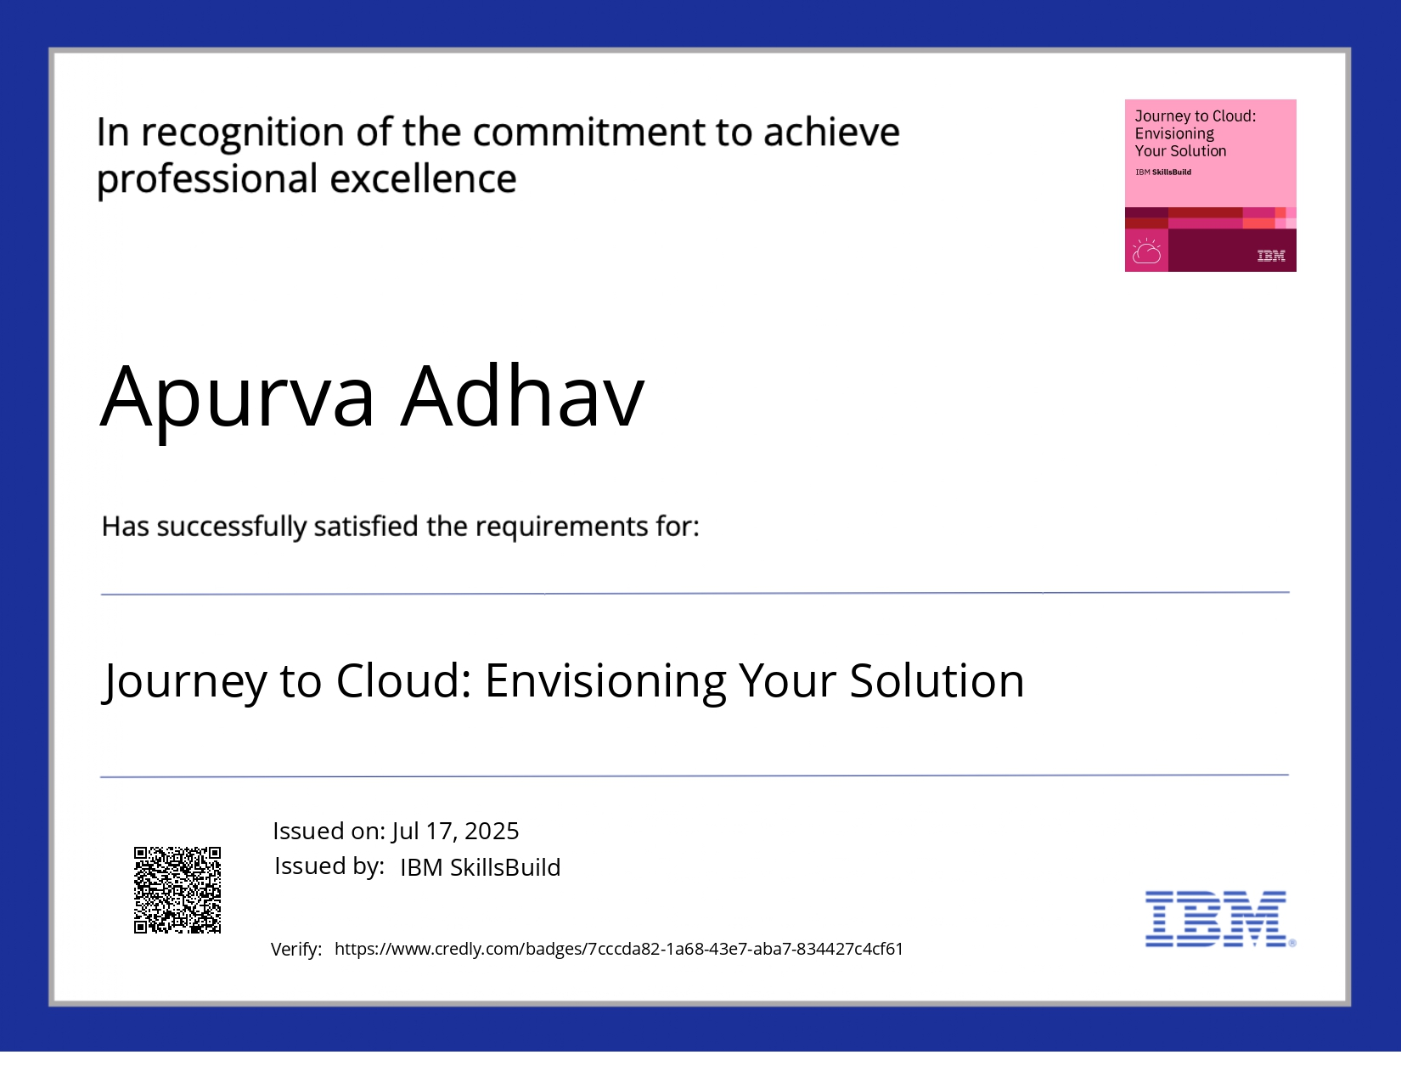
IBM Certifications
Screenshot/ credly certificate( Journey to Cloud)

Slide 16
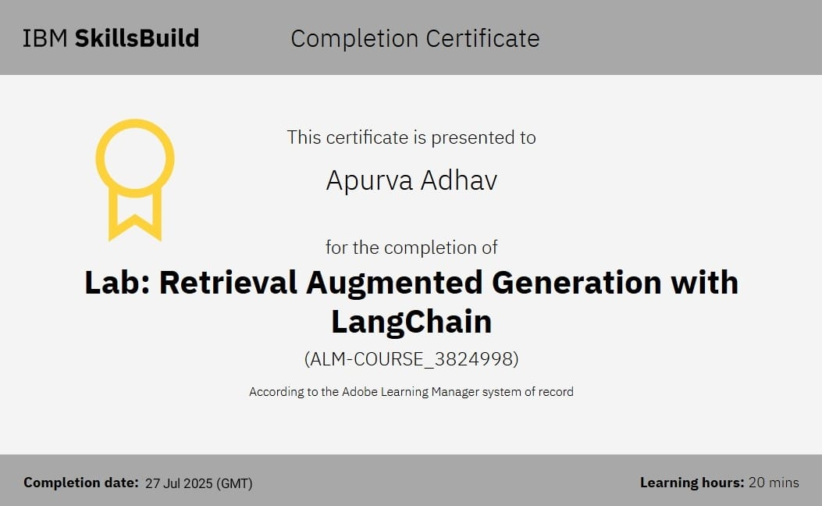
IBM Certifications
Screenshot/ credly certificate( RAG Lab)

Slide 17
THANK YOU

